Slide 1
The Equity Agenda
Achieving Racial Justice in Massachusetts Public Higher Education

Slide 2
Equity Principles
The Equity Agenda
Racial equity:
Is the top policy and performance priority for the Department of Higher Education
Will be achieved when race no longer determines one’s outcomes in the Massachusetts public higher education system
Must be embedded system-wide and permeate the Department’s structure, culture, and policies
Requires the use of asset-based language to minimize the threat of harm, deficit, and stereotype reinforcement
“Asset-based language” defines people by their aspirations and contributions, rather than the systemic barriers and challenges they face
Requires acknowledgement, remedy, and repair of policies and practices which have excluded or created barriers

Slide 3
Equity Principles
The Equity Agenda
We must:
Recognize that clarity in language, goals, and measures is vital to racially equitable practices
Promote culturally sustainable campus climates in which all students can thrive and are regarded in the totality of their human dignity
“Culturally sustainable” means recognizing, maintaining, and developing cultural identity and diversity, as they are assets, not weaknesses (Ladson-Billings, 1995; Paris, 2012)
Create and cultivate an inclusive environment to encourage the support and participation of relevant stakeholders
Acknowledge the experience and knowledge of people of color, and seek to engage people of color in the pursuit of racial equity in meaningful ways
Incentivize the development and support the implementation of equity-minded, evidence-based solutions

Slide 4
Participatory Leadership
To achieve racial equity, DHE has developed various formal and informal networks to catalyze and support staff in developing knowledge, building relationships, and implementing policy changes
Build knowledge, awareness, and skills of every individual to change one’s beliefs and actions, both conscious and unconscious, that serve to perpetuate oppression
Bring people together, both within and across groups, to build relationships of trust and solve problems collectively
Acknowledge, remedy, and repair policies and practices at the agency and system levels that have excluded or created barriers
Inspired by National Equity Project and Maggie Potapchuk (Cultivating Interdependence: A Guide for Race Relations and Racial Justice Organizations, 2004)

Slide 5
Participatory Leadership
Networks include but are not limited to: | Individual | Groups | Agency and System
Internal Communications & Professional Development DHE ICPD Working Group DHE Community Conversations DHE Equity Book Club DHE Equity Institutes (completed) and future professional development |  | 
Policy & Program Design DHE Policy & Program Audit Learning Community BHE Committees & Full Board |  |  | 
New Undergraduate Experience Design Steering Committee Student-Ready Institutions Committee Teaching & Learning Committee |  |  |  | 
Coalition Building DHE Strategic Communications Team Equity Coalition |  |  |  | 
To achieve racial equity, DHE has developed various formal and informal networks to catalyze and support staff in developing knowledge, building relationships, and implementing policy changes

Slide 6
The New Undergraduate Experience

Slide 7
What was The Undergraduate Experience ?
60 pp. report, with 44 recommendations
Focused on the 28 undergraduate-serving institutions
Re-envisioned the undergraduate experience in public higher education with the goal of enhancing “excellence”
Presented to and accepted by the Board of Regents in June, 1989, and Chancellor Jenifer was directed to implement forthwith
Implemented over three academic years: 1989-1990 to 1991-1992

Slide 8
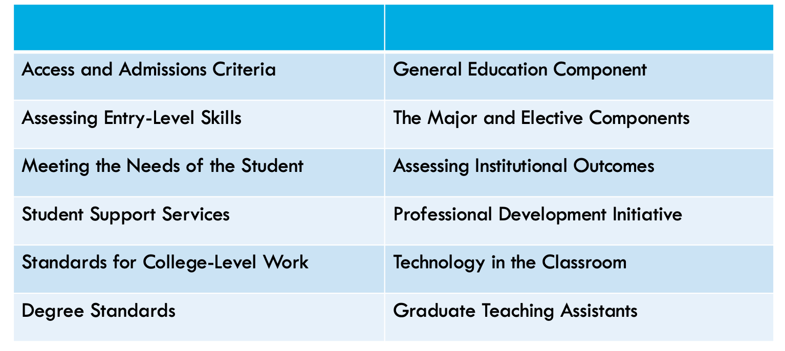
What was The Undergraduate Experience ?
Original Table of Contents

Slide 9
Why is it time to re-imagine the UE?
Racial Equity and Justice
An urgent challenge and an opportunity
Evolving best practices in higher education
Inclusive, high-impact pedagogies
Student development and integrative learning
Understanding of barriers facing students
Online education in a pandemic and post-pandemic age
New economic context
Income inequality and the digital divide
Cost of higher education and the ROI
Concerns about demographics and enrollment
New social context
Increasing diversity of Massachusetts students in every sense of the term but a growing opportunity gap

Slide 10
A New Framework with New Priorities
The New Undergraduate Experience
Dismantling Systemic Barriers
Inclusive Campus Climate
Holistic Support Services
Recognizing Students' Cultural Wealth
Equity-Minded Assessment
High Impact Practices
Culturally Responsive Curriculum and Pedagogies
STUDENT-CENTERED
CIVIC RESPONSIBILITY
ADVANCING RACIAL EQUITY

Slide 11
NUE Committee Membership
All 29 institutions represented
Highly diverse state and national “brain trust” which includes BHE members, Presidents, CAOs, CSAOs, CDOs, the AAC&U, Massachusetts industry, community and education partners, as well as faculty, staff, and students “on the ground”
Supported by DHE staff serving on each committee

Slide 12
Committees and Structure
Steering Committee
Co-Chairs: Patty Eppinger and Dr. Constanza Cabello
Teaching and Learning Committee
Tri-Chairs: Dr. Paul Hernandez, Cynthia Lynch, and Dimitri Moore
Student-Ready Institutions Committee
Tri-Chairs: Dr. Deanna Yameen, Marquis Taylor, and Dezary Guzman
Faculty, Curriculum and Pedagogy
Professional Development and Assessment
Foundational Elements
Institutional Culture
Transitions
Holistic Student Supports

Slide 13
What could a new version look like?
Redesigning Systems & Structures
Visionary Aspirational
Challenging Norms
Transformational

Slide 14
Timeline and Outcomes
December 2020
New Undergraduate Experience Kickoff Event
January-May 2021
Committees develop and refine recommend-ations; Steering committee vets
Fall 2021
DHE launches Strategic Planning process informed by NUE Final Report and the Policy and Program Audit
June 2021
BHE/AAC reviews draft report and recommend-ations, provides feedback
October 2021
NUE Final Report and Recommend-ations to be brought before the BHE

Slide 15
Equity Agenda Policy and Program Audit

Slide 16
Policy & Program Audit
Audit and assess all policies & programs
Identify and remove those that exacerbate racial inequity
Collaborate with public institutions to inform new policy direction
Address education debt owed to Black and Latinx students
Form DHE Learning Community to support cultural transformation
Partner with Board of Higher Education to advance Equity Agenda

Slide 17
Sample Prompts
Policy & Program Audit
Racial equity is the top policy and performance priority for the Department of Higher Education.
Does the policy or program reflect that racial equity is the top policy and performance priority for the Department of Higher Education?
Racial equity requires acknowledgement, remedy, and repair of policies and practices formulated for the purposes of exclusion.
What is the origin and history of this policy or program? Did the policy or program have the intention or effect of excluding or creating a barrier to students who identify as Black and/or Latinx?
Clarity in language, goals, and measures is vital to racially equitable practices.
What clear measures or goals associated with this policy might better support more equitable outcomes for Black and/or Latinx students?

Slide 18
Sample Prompts
Policy & Program Audit
Racial equity requires the use of asset-based language to minimize the threat of harm, deficit, and stereotype reinforcement.
How could this policy or program language be reshaped to promote asset-based and inclusive language?
Racial equity requires that the Department promote culturally responsive campus climates in which all students, faculty, and staff can thrive, and in which all students, faculty, and staff are seen and regarded in the totality of their human dignity.
Does this policy or program have an impact on the lived experiences of prospective students, enrolled students, faculty, or staff who identify as Black and/or Latinx?
The Department must create and cultivate an inclusive environment to encourage the support and participation of relevant stakeholders.
Were relevant stakeholders and/or students involved in the development of this policy?

Slide 19
Sample Prompts
Policy & Program Audit
Racial equity includes continuously conducting rigorous critical evaluation.
Assuming this policy either ensures or will be changed to ensure it reflects racial equity as the top performance priority, what requisite data (quantitative and qualitative) and analysis will be necessary for the Department to be evaluated relative to equity related outcomes?
The Department must incentivize the development and support the implementation of equity-minded, evidence-based solutions.
What are equity-minded, evidence-based solutions of any disparity or racial inequity in this policy?
Racial equity requires budgeting reflecting racial equity as a top priority, and which seeks to rectify the harms of a history of racist policy.
How might the budgeting reflected in this policy be adjusted to make real a commitment to racial equity?

Slide 20
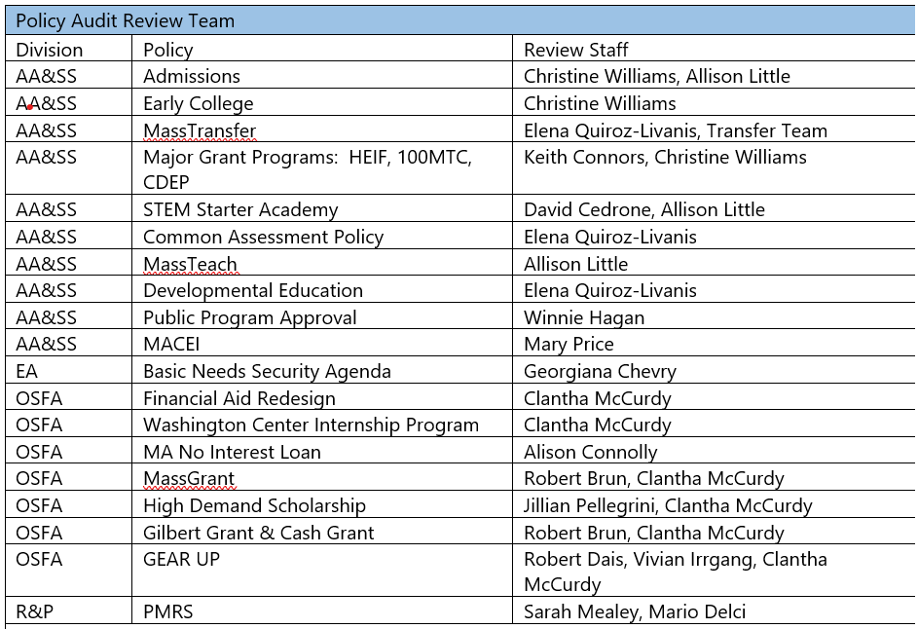
Policy Audit Learning Community Structure and Timeline
Audit of first set of policies to be completed by August 15, 2021
Learning Community will meet quarterly
DHE Equity Agenda leads will meet with each divisional team in between full LC meetings
Support teams will offer teach-ins
Collaboration and conversation among LC encouraged

